Slide 1

Camel Quarkus
Supersonic Subatomic Apache Camel
Zineb Bendhiba
@ZinebBendhiba
AlpesJUG 2023

Slide 2




About
Zineb Bendhiba
Senior Software Engineer at Red Hat
Apache Camel committer
Duchess France
Based in Paris - France
She/Her
Twitter : @ZinebBendhiba
GitHub : zbendhiba

Slide 3

https://www.flickr.com/photos/kaptainkobold/3203311346/in/photostream

Slide 4












Apache Camel can set you free
My
System
Another System
Your
System
350+ components!
‹#›

Slide 5
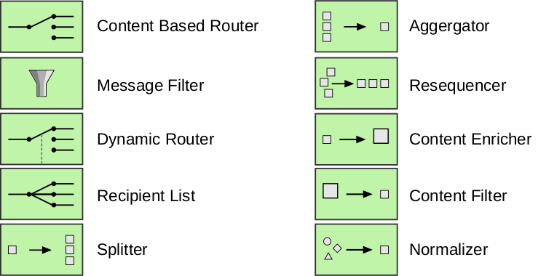
Enterprise Integration Patterns
https://www.enterpriseintegrationpatterns.com/

Slide 6
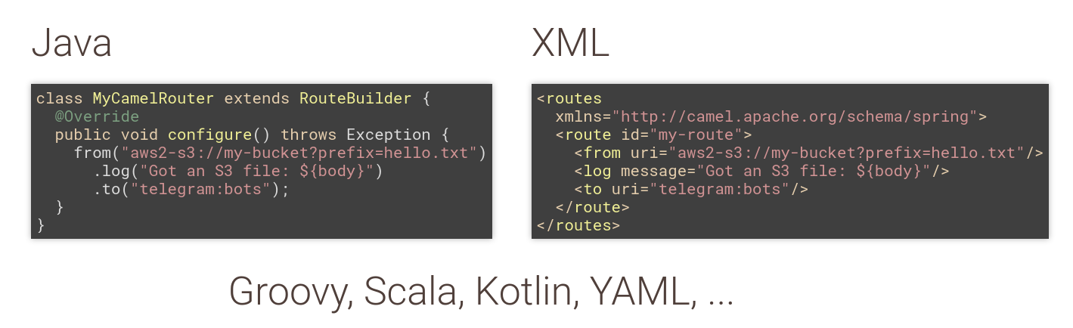
Domain Specific Languages (DSL)

Slide 7

Supported Platforms

Slide 8
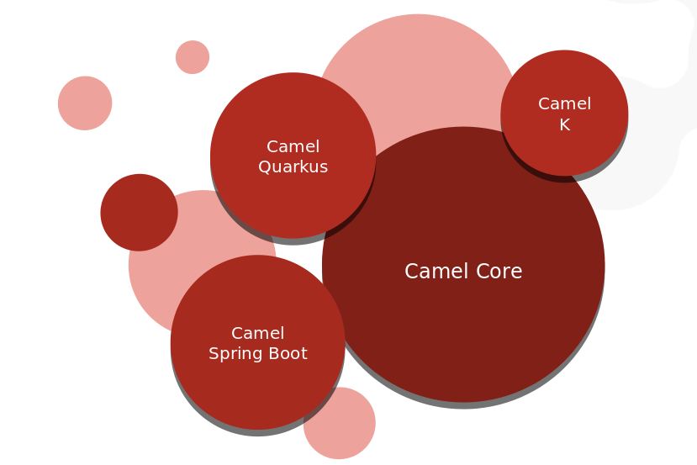
The Apache Camel project

Slide 9
Camel 4

Slide 10
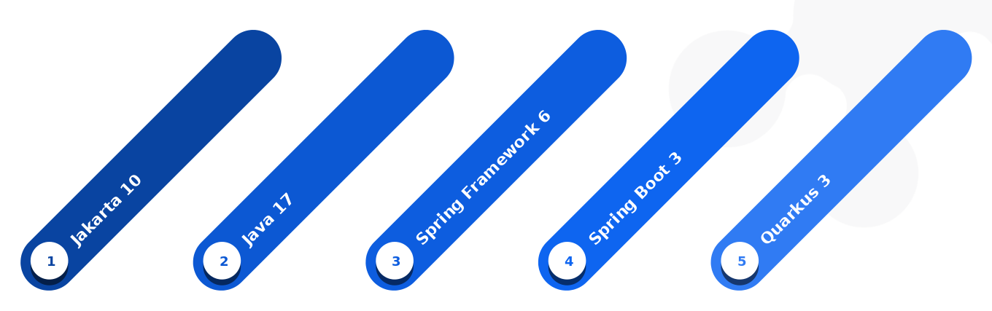
Motivations for Camel 4

Slide 11
Camel 4
Java 17
Camel Karaf (OSGI) as a best effort
Decouple Camel Karaf releases from Camel Core
Internal cleanups
Drop legacy features & deprecated components
Performance improvements

Slide 12
Camel on Quarkus

Slide 13
Camel Quarkus
Camel Quarkus brings together the awesome integration capabilities of Apache Camel and its vast component library to the Supersonic, Subatomic Quarkus runtime

Slide 14
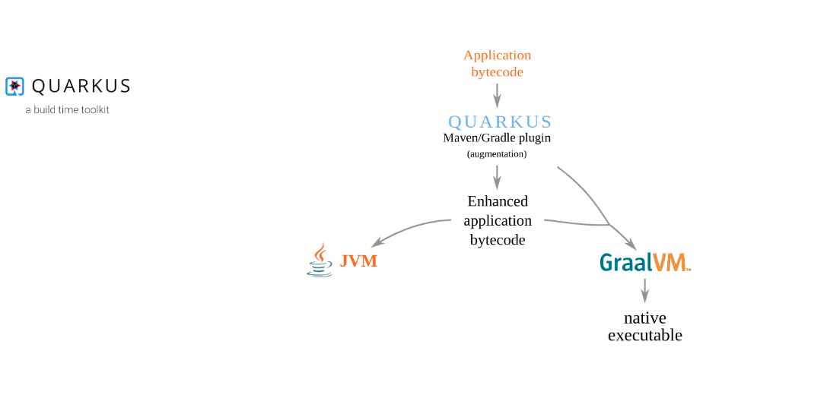
Quarkus

Slide 15
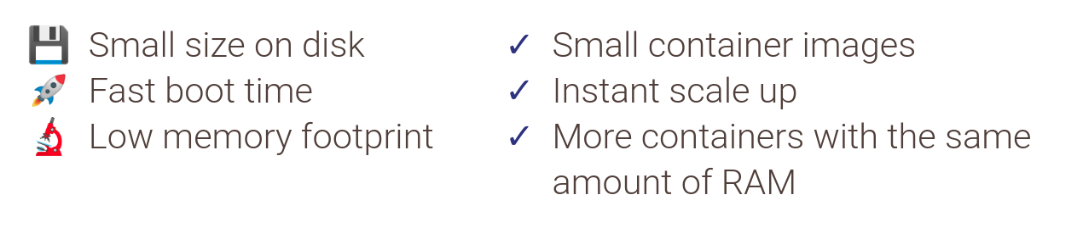
Camel Quarkus

Slide 16
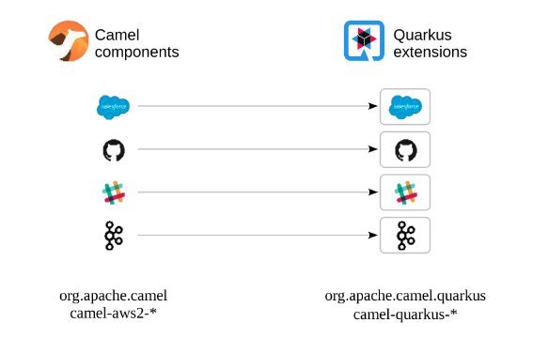
Camel Quarkus

Slide 17
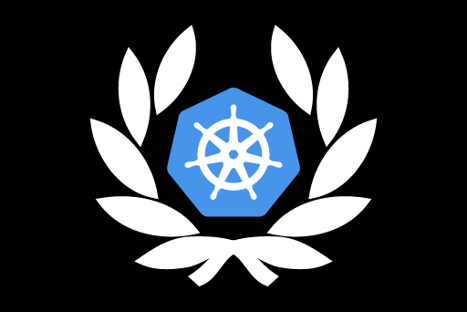
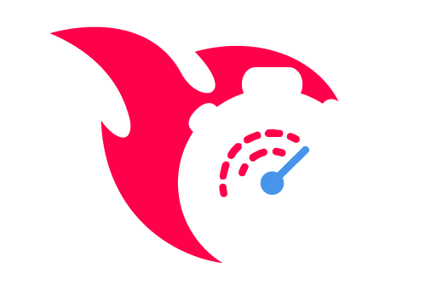

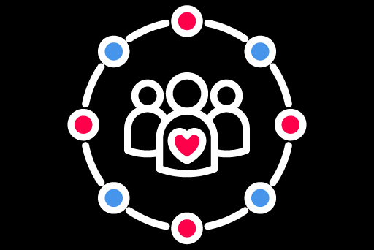
Quarkus 3 Highlights
PERFORMANCE
PRODUCTIVITY
KUBE-NATIVE
STANDARDS
Hibernate ORM 6
Pact contract testing support
New Dev UI
Azure Functions extension
Kubernetes DevService
Quarkus CLI deploy to Kubernetes
Java 11 & 17
Aligns with MicroProfile 6 & Jakarta EE Core Profile 10
Learn more at Quarkus.io/quarkus3
Notes:
Performance - ”supersonic, subatomic Java”
Productivity - “Come for the performance, stay for the productivity”
Kube-native - “Built for the cloud”
Standards - “Community & standards”

Slide 18
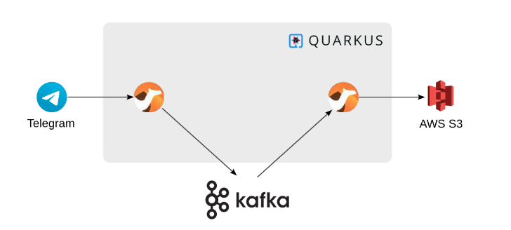
Camel Quarkus Demo

Slide 19
Camel JBang

Slide 20
Camel 4
Quick way to start running integration code
Great for prototyping
Simplifies bootstrapping new projects
Provides functionality for other projects
$ camel run my-integration.yaml

Slide 21
Camel K

Slide 22
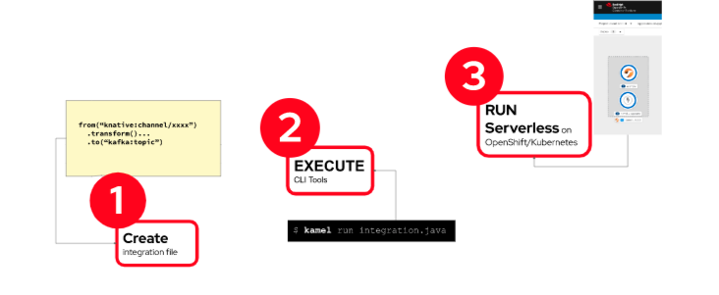
Camel K overview

Slide 23
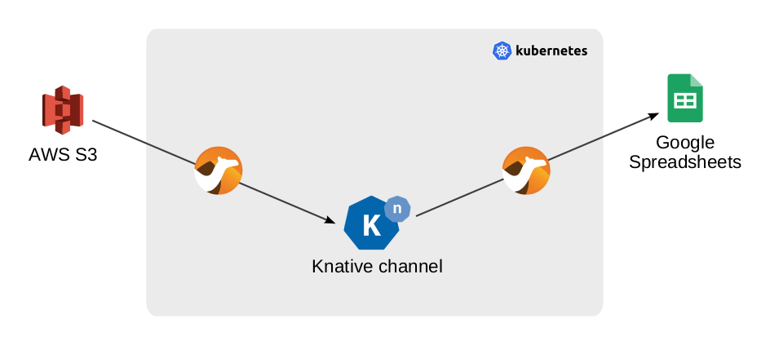
Camel K Demo

Slide 24
Wrap up

Slide 25
Wrap up
Apache 🐪 = an integration toolkit with 350+ connectors
🚀🔬😍 on Quarkus
Scale to 0️⃣ and easy to deploy to Knative
Stream data from/to Kafka

Slide 26

https://camel.apache.org
Chat: https://camel.zulipchat.com
Mailing list: dev@camel.apache.org
Follow @ApacheCamel

